Slide 1
Healthcare Analysis – Dialysis of Patients
Group – 6
. Jayesh Sharma
. Emamul Arfine
. Ashwal Hedge
. Shubham Shetty
. Sai Ravi Teja
Date – 17-02-2024

Slide 2

* What is Healthcare
Healthcare allows improvement
Of health vie the prevention , diagnosis
And treatment of disease

Slide 3








Top 10 Organization

Slide 4

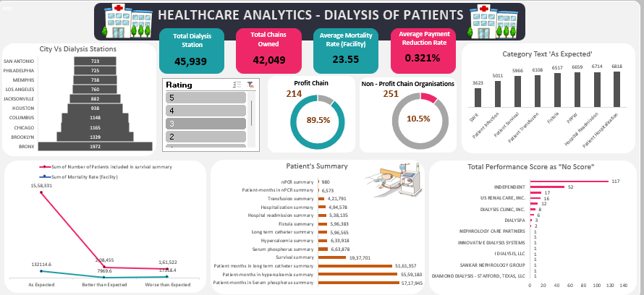
Excel Dashboard

Slide 5

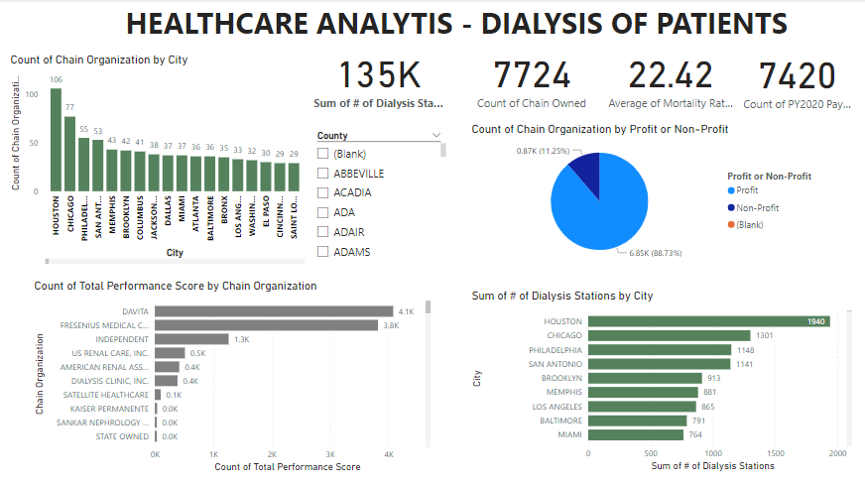
Power BI Dashboard

Slide 6

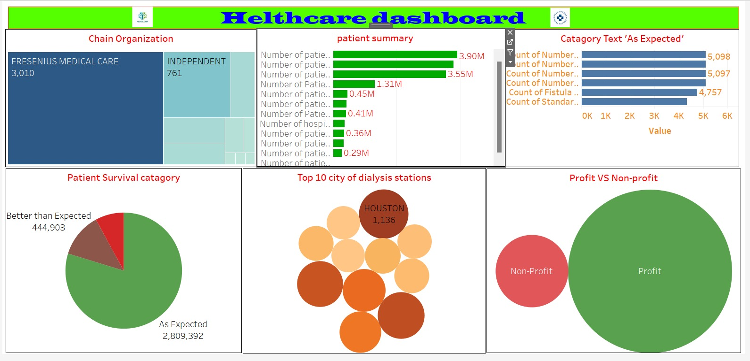
Tableau Dashboard

Slide 7

My SQL

